Slide 1

Oromia State University College Of Science And Technology Department Of Informtion Technology
Oromia State University.
Mobile assisted maternal health Advisory system for Batu Health Center

Slide 2
Group Name
NAME ID
Lense Adugna…… PIT/R/13/01009
Aseggedech Deressa PIT/R/13/01001
Gebi Kedir..............PIT/R/13/01004

Slide 3
Outline
01
Introduction
Background of Organization.
03
Statement of Problems
02
04
Objective
Scope and Limitation
05
06
Beneficiaries of the Application
07
Methodology
Feasibility study
09
Project Plan
08

Slide 4
Introduction
- Mobile assisted maternal health advisory system is simply a mobile application that helps mothers or physician to get necessary information about maternal health and perform communication between mothers and physician or family planning workers.
- Typically, this application is exceedingly useful for a mothers or physician when they are far from each other and busy.

Slide 5
Background of Organization
- Batu Health Center was established in 1953 by the Oromia Health Bureau and consists of seven Board members. The board is headed by the office of the mayor of Batu. Although nothing is known about how many employees the organization started when it was established, it currently has sixty eight (68) employees.

Slide 6
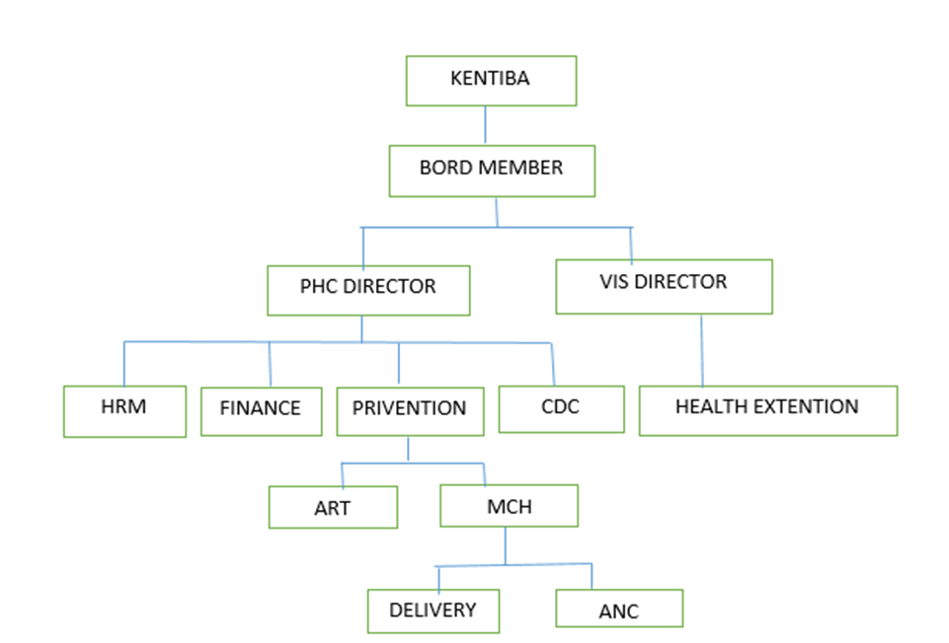
Organization Structure

Slide 7

Statement of Problems
Most pregnant women do not receive antenatal care.
Maternal mortality and unnecessary pregnancy increased.
Time and cost wastage to get health centers
Women often lack access to relevant information, trained providers and supplies, and other essential services.
Poorly timed unwanted pregnancies carry high risks of morbidity and mortality

Slide 8
Objective
General objectives
- The general objective of this project is to develop a Mobile assisted maternal health Advisory system for Batu Health Center

Slide 9
Cont….
Specific Objectives
To design interactive GUI using XML.
To implement the proposed system.
To Design a database.
To establishing a maternal health counseling system supported by mobile phones
To establishing a system where mothers can easily find solutions to their problems.
To establish a system that allows mothers to easily communicate with the health care professionals of Batu Health Center.

Slide 10
Scope and Limitation
Scope
Can get necessary information from the application installed on their mobile.
Get detail advice and recommendation from physicians using chat, SMS, and call
Remember take a medicine and how to use it.
Remember appointment with health centers
Can register to the application to access the information

Slide 11
Cont…
Limitation
The system will not work unless network connection is available at the time.
The system will not work unless the user device has enough balance to access internet.
The physician will not prescribe a medicine to mothers but they will make them aware about their problem and make them to visit close health station.

Slide 12
Beneficiaries of the Application
Family Planning workers
Mothers
Batu Health Center
Developers

Slide 13
Significance of the Application
Automatically generate the reports
Reduce time, cost and redundancy of information or data.
Improving efficiency, control and security of existing system.
It provides accurate output and fast answer of queries.

Slide 14
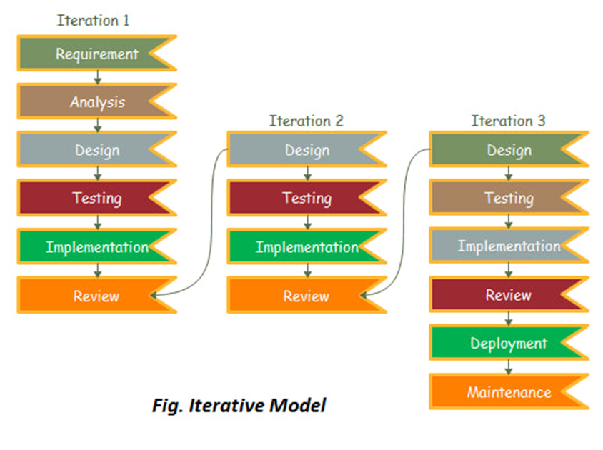
Methodology
Data collection Tools/Techniques
System Development Model

Slide 15
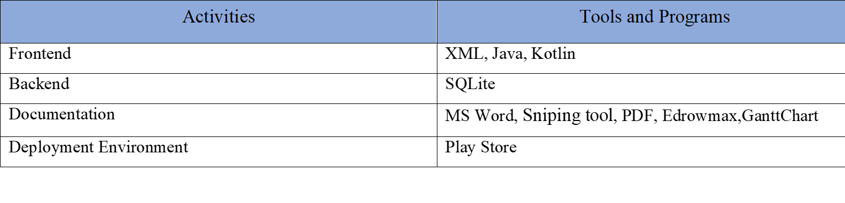
Cont…
Development Environment and Tools

Slide 16
Feasibility study
Feasibility study allows project managers to investigate the possible negative and positive outcomes of a project before investing too much time and money.
Economic feasibility
Technical feasibility
Time feasibility
Operational feasibility

Slide 17
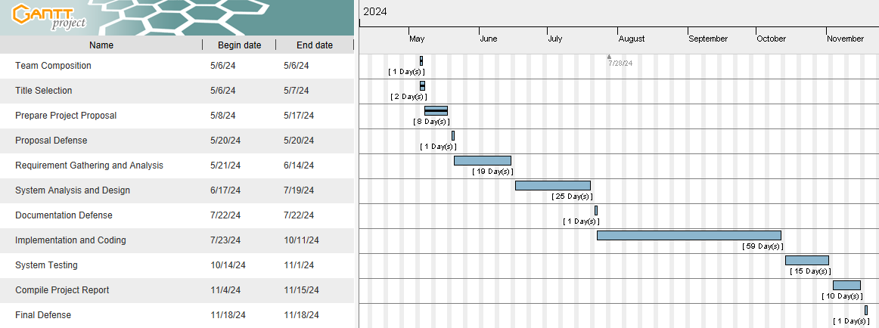
Project Plan
Time Schedule

Slide 18
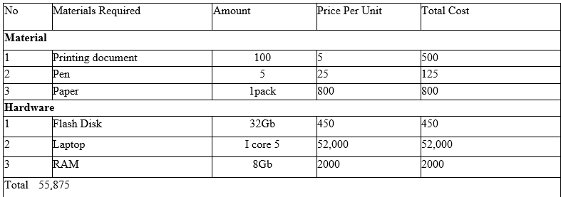
Cont….
Budget
- Hardware Requirement

Slide 19
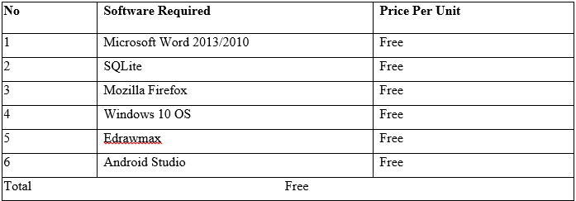
Cont…
Software Requirements Cost

Slide 20
Conclusion
This proposal the development of a mobile-assisted maternal health advisory system for Batu Health Center. The system aims to improve access to healthcare services and communication between mothers and healthcare professionals.

Slide 21
Reference
https://www.google.com.et/#q=LN_maternal_care_final+pdf
https://poe.com/chat/2b29fj4g83g3c50siia
MOH: National Reproductive Health Strategy 2006 - 2015. Federal Democratic Republic of Ethiopia, Ministry of Health.: Addis Ababa, Ethiopia; 2006

Slide 22
Thank you for your Attention!!!!
Do you have any questions?
lenseadugna@gmail.com
aseggedechderessa@gmail.com
gebikedir71@gmail.com

